Slide 1

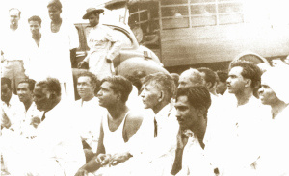

TYO
UK
SINHALA ONLY ACT
This was a bill introduced on June 5th 1956, declaring that the one and only official language of the country was Sinhala, replacing English following the colonial period.

Slide 2
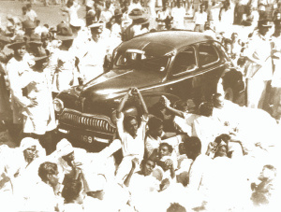
What did the “Sinhala Only Act” state?
THIS ACT MAY BE CITED AS THE Official Language Act, No. 33 of 1956. Sinhala Language to Be the One Official Language of Ceylon and to enable transitory provisions to be made.

Slide 3
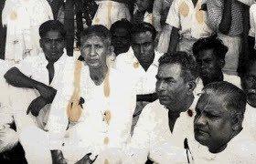
THE ONE OFFICIAL LANGUAGE, INTRODUCING THE SYMBOL OF OPPRESSION!

Slide 4
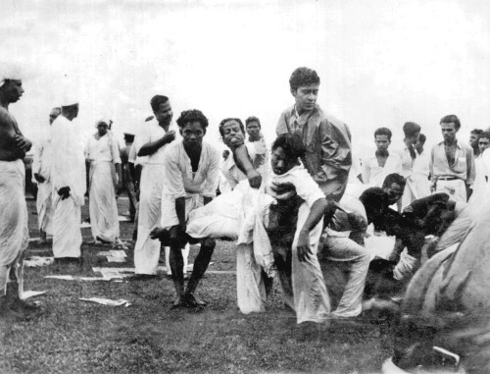
How did Tamils react to the “Sinhala Only Act”?
TAMIL FEDERAL PARTY ORGANISED A PEACEFUL PROTEST, SATYAGRAHA, OUTSIDE THE PARLIAMENT BUILDING. THIS PEACEFUL PROTEST WAS MET BY A COUNTER-PROTEST ORGANISED BY EKSATH BHIKKHU. AN ORGANISED MOB OF SINHALA HOOLIGANS, ATTACKED THE TAMIL PROTESTERS AND WAS RESPONSIBLE FOR UNLEASHING RIOTS, KILLING AROUND 150 TAMILS.

Slide 5
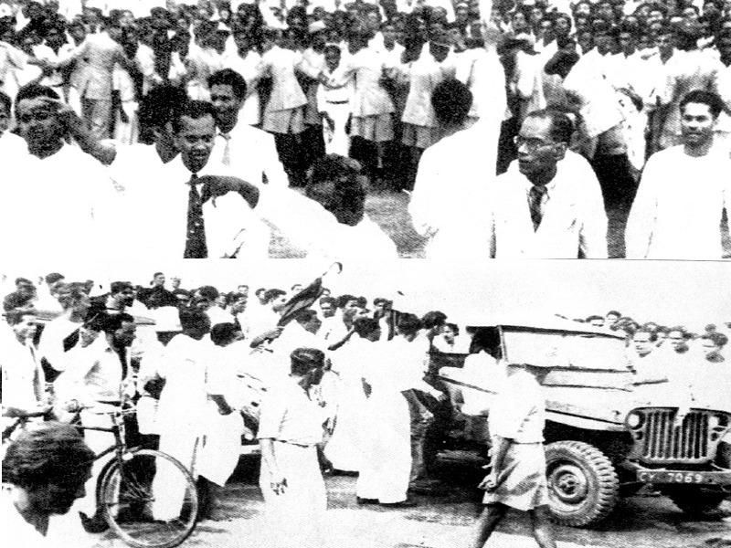
THE CIVIL SERVICE WAS DOMINATED BY TAMILS IN 1955. DUE TO THE INTRODUCTION OF THE “SINHALA ONLY ACT’, THE CIVIL SERVICE WAS ALMOST ENTIRELY SINHALESE. THOUSANDS OF TAMIL CIVIL SERVANTS HAD BEEN FORCED TO RESIGN DUE TO THEIR LACK OF FLUENCY IN SINHALESE.
What effect did this have?

