Slide 1

TAMILEELAM FLAG
LET’S EDUCATE OURSELVES

Slide 2
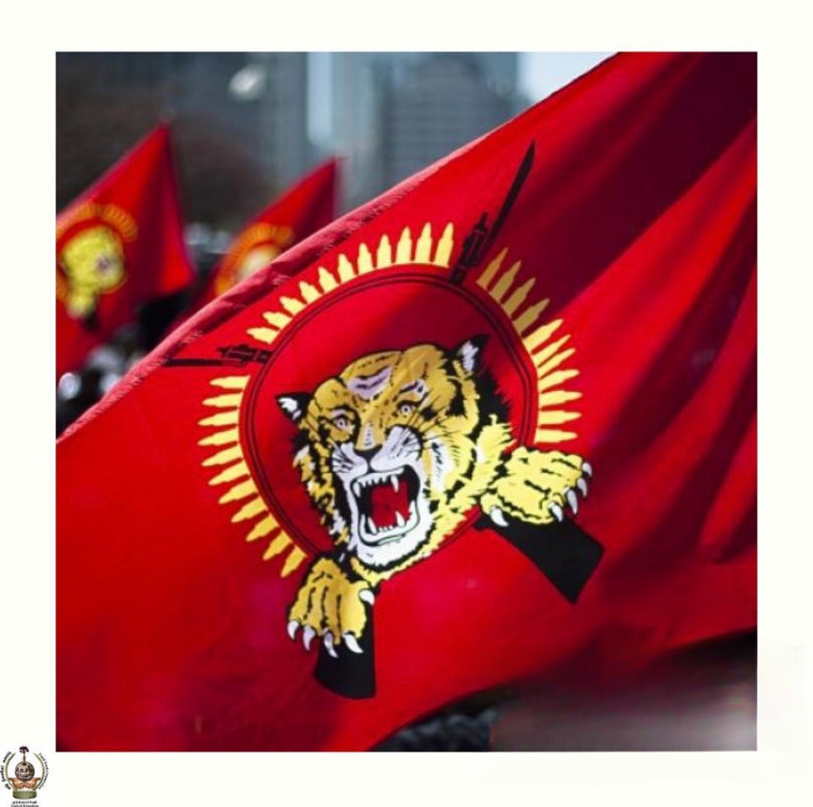
RED
A representation that an independent state of Tamileelam will not bring freedom by itself. That Tamils will gain true freedom through the abolishment of caste and class distinction through social justice. That gender equality and equalitarian principles need to be applied across Tamileelam.

Slide 3
Yellow
A representation of the aspirations for Tamils to govern their own homeland and presents the moral high ground of which our path to freedom exhibits

Slide 4
Black
A representation of understanding that the journey for our freedom will encounter deaths, destruction, misery and pain. The steadfast determination for Tamileelam and the protection of our borders.

Slide 5
White
A representation of honesty, selflessness and purity in the citizens and leaders of Tamileelam.

Slide 6
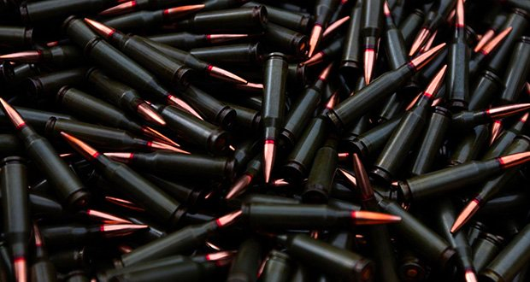
Bullets
The 33 bullets represent the number of years of historical oppression upon Tamils following the independence of the Sri Lankan State, until the outbreak of the armed struggle.

Slide 7

Crossed Bayonets
The representation of the armed struggle for Tamils based off the crossed swords as illustrated on Pandara Vanniyan, the last Tamil King of Vanni’s flag.

Slide 8

The Leaping Tiger
From the historical Tamil kingdom, Chola Empire. The Tiger or Jumping Tiger was the royal emblem of the Cholas, mentioned in Periya Puranam.

